Slide 1
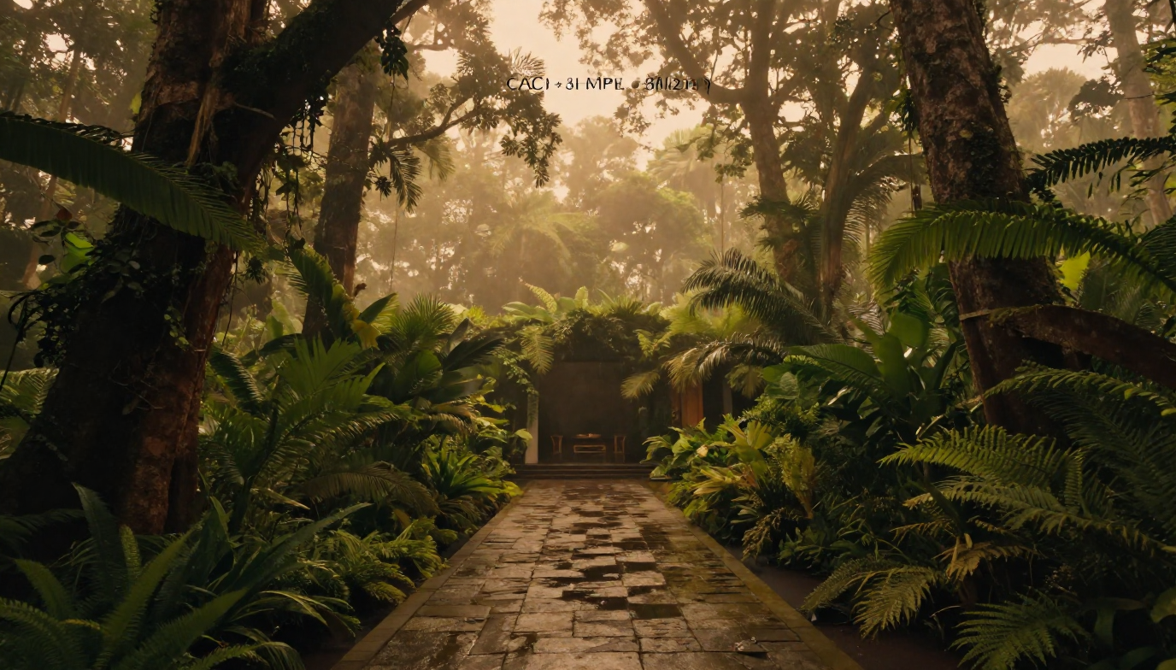
∀LCHƎMY | Costa Rica
Vision & Collaboration Overview
A vision for a holistic regenerative wellness sanctuary.
Originated and led by Tӑ Millen
Founder & Principal
The Alchemist’s Realty & Design, LLC
Public Vision Overview | October 2026
Concept visualization — proposed experience
∀LCHƎMY | Costa Rica • Public Vision Overview • October 2026

Slide 2
02
A living landscape for restoration, culture, and connection.
∀LCHƎMY | Costa Rica envisions a place where restorative stays, holistic wellness, botanical traditions, food, creativity, and connection to the natural world reinforce one another.
The intention is to develop a coherent experience of place: welcoming, thoughtfully designed, culturally responsive, and grounded in responsible relationships with land and community.
∀LCHƎMY | Costa Rica • Public Vision Overview • October 2026

Slide 3
03
An intentional vision, moving through development planning.
∀LCHƎMY | Costa Rica is an evolving development vision in planning and predevelopment exploration.
Site selection, legal and operating structure, feasibility, capitalization, design, and approvals remain to be resolved.
This presentation introduces the vision and opportunities for conversation. It does not announce an operating destination or an available investment offering.
∀LCHƎMY | Costa Rica • Public Vision Overview • October 2026

Slide 4
04
The next chapter grows from work already underway.
Founded in 2020 in Downtown Austell, Georgia, The Alchemist Den brings together botanical retail, natural lifestyle products, spiritual inquiry, wellness, and community gathering.
Its identity has been shaped by a commitment to belonging, including a welcoming space for Queer communities of color and people seeking meaningful connection.
∀LCHƎMY carries these values into a broader development vision in Costa Rica.
∀LCHƎMY | Costa Rica • Public Vision Overview • October 2026

Slide 5
05
Translating an ecosystem into a development vision.
The Alchemist Den demonstrates how products, practices, relationships, and gathering can connect within a shared philosophy.
∀LCHƎMY explores how those relationships could be expressed through land use, architecture, hospitality, landscape, and thoughtfully coordinated experiences.
The development ambition is larger than a retail expansion. It connects the experience of place with the systems required to sustain it.
∀LCHƎMY | Costa Rica • Public Vision Overview • October 2026

Slide 6
06
Tӑ Millen | The Alchemist
Tӑ Millen is a community developer, residential and commercial real estate developer, and design strategist.
As Founder & Principal of The Alchemist’s Realty & Design, LLC, Tӑ originates development concepts and brings together the relationships, professional expertise, and planning required to advance them.
Tӑ is the originating founding principal of the ∀LCHƎMY development vision, leading its development strategy and creative direction through TARAD.
∀LCHƎMY | Costa Rica • Public Vision Overview • October 2026

Slide 7
07
TARAD | Vision, structure, and coordination.
The Alchemist’s Realty & Design, LLC is the developer-sponsor platform for ∀LCHƎMY. TARAD partners with investors, landowners, municipalities, nonprofits, builders, and other professionals to advance financially viable, culturally responsive, community-aligned projects. Its work bridges private development goals and public-facing outcomes, with attention to housing, sustainability, workforce pathways, and long-term community vitality.
Technical design and regulated professional services require appropriately qualified project professionals.
∀LCHƎMY | Costa Rica • Public Vision Overview • October 2026

Slide 8
08
A practice shaped by community, enterprise, and transformation.
Tӑ’s work spans the creation of The Alchemist Den, nonprofit leadership through Fertile Ground Incorporated, community gathering, real estate and development strategy, and spiritual practice.
Relevant experience includes service as a former Austell Business Association President and organizing the inaugural Fae, Fairies, Family & Seahorses community festival in 2026.
Tӑ is also a Reiki Master, spiritual advisor, and published author.
∀LCHƎMY | Costa Rica • Public Vision Overview • October 2026

Slide 9
09
Development leadership and wellness perspectives.
Tӑ leads the development vision through TARAD.
Chasity Millen contributes wellness perspectives, relationship-building, community engagement, and the envisioned future operating ecosystem, including the perspective of Love & Light Healing.
The Alchemist Den connects the vision to an established philosophy, customer community, and experience of welcoming people into shared space.
∀LCHƎMY | Costa Rica • Public Vision Overview • October 2026

Slide 10
10
Distinct organizations. Connected values.
The Alchemist’s Realty & Design, LLC
Rhythm & Black
Developer-sponsor platform and development coordination.
Food, beverage, and gathering perspective.
The Alchemist Den
Fertile Ground Incorporated
Established botanical retail, natural lifestyle, wellness, and community connection.
Distinct nonprofit work in housing stability and community development.
Millenheirs
True Alchemy Gardens, Inc.
Natural lifestyle brand and product perspective.
Distinct nonprofit work connected to food access, gardens, and environmental stewardship.
Love & Light Healing
Holistic wellness perspective.
Shared values do not establish common ownership, pooled funds, or formal Costa Rica operating roles. Future relationships require appropriate agreements.
∀LCHƎMY | Costa Rica • Public Vision Overview • October 2026

Slide 11
11
A place to engage thoughtfully.
Costa Rica is the setting being explored for this next chapter.
The vision calls for learning from the people, landscapes, practices, and conditions of the place before determining what should be built.
Architecture, programming, sourcing, and operations should respond to local realities and develop through respectful relationships.
∀LCHƎMY | Costa Rica • Public Vision Overview • October 2026

Slide 12
12
Design the relationships, not only the buildings.
Restorative hospitality.
Holistic wellness and learning.
Botanical and culinary experience.
Culture, creativity, and belonging.
Responsible land stewardship.
The value of the concept lies in how these experiences relate to one another and to the place that supports them.
∀LCHƎMY | Costa Rica • Public Vision Overview • October 2026

Slide 13
13
Restoration woven into everyday movement.
The envisioned experience unfolds through arrival, rest, nourishment, exploration, reflection, and gathering.
Landscape and architecture would support that movement through shade, planting, framed views, outdoor rooms, contemplative paths, and connections between shared and private space.
The experience should feel coherent rather than assembled from unrelated attractions.
∀LCHƎMY | Costa Rica • Public Vision Overview • October 2026

Slide 14
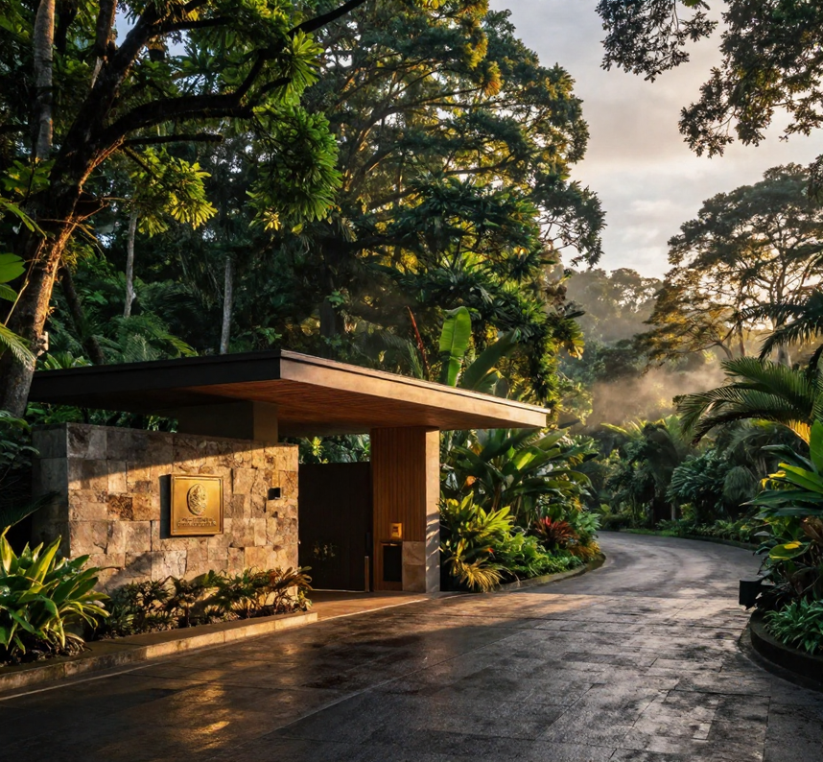
14
Space to arrive, settle, and reconnect.
The hospitality vision favors privacy, comfort, attentive service, and meaningful connection to the surrounding landscape.
Accommodation concepts may explore indoor-outdoor living, natural textures, sheltered terraces, and spaces for both solitude and shared experience.
The final accommodation program will depend on site suitability, feasibility, design, and approvals.
Concept visualization — proposed experience
∀LCHƎMY | Costa Rica • Public Vision Overview • October 2026

Slide 15
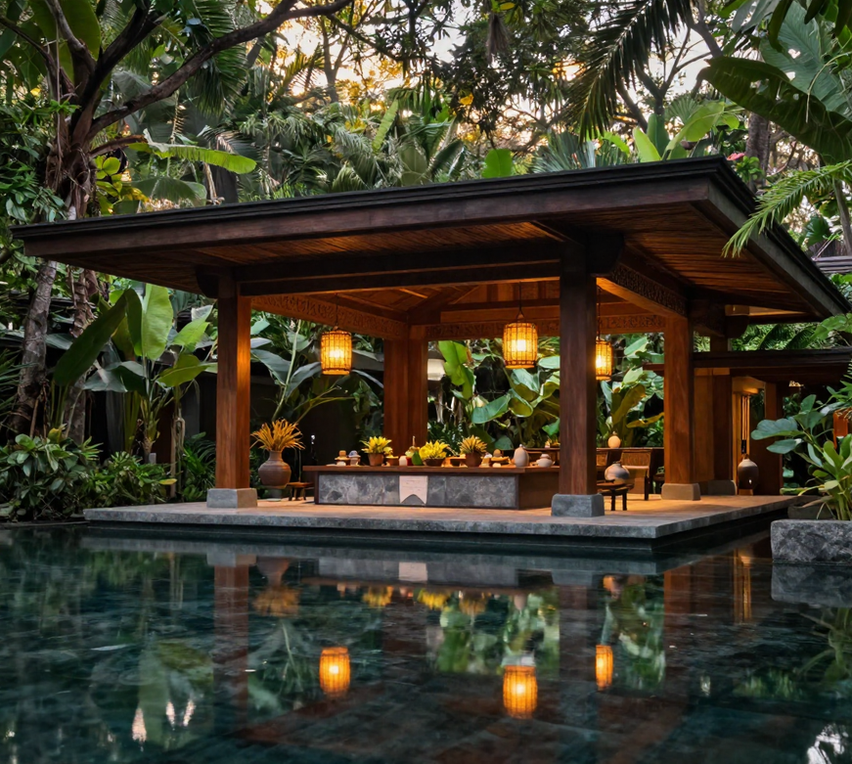
15
Architecture shaped by climate and place.
The design direction explores low-rise forms, deep shade, generous overhangs, natural materials, curved elements, and a strong relationship between interior and exterior space.
Durability, comfort, maintainability, and environmental suitability should inform the design alongside beauty.
Concept imagery illustrates atmosphere and direction. It is not a representation of an approved design.
Concept visualization — proposed experience
∀LCHƎMY | Costa Rica • Public Vision Overview • October 2026

Slide 16
16
Practices that support rest, reflection, and connection.
The wellness vision includes possibilities for meditation, breathwork, mindful movement, guided reflection, botanical education, and practitioner-led experiences.
Transformational Alchemy and Herbal Alchemy inform the broader philosophy of intentional becoming and relationship with the natural world.
Programs would be developed with appropriate professional oversight and clearly defined scopes of practice.
∀LCHƎMY | Costa Rica • Public Vision Overview • October 2026

Slide 17
17
A thoughtful encounter with the living world.
Potential experiences include forest bathing, interpretive walks, bird observation, contemplative trails, outdoor movement, and guided learning.
Equestrian or water-based experiences may be evaluated where appropriate and delivered through suitable facilities or qualified local providers.
The intent is to deepen attention and connection while respecting ecological conditions, safety, and community practices.
∀LCHƎMY | Costa Rica • Public Vision Overview • October 2026

Slide 18
18
Plants as a thread through the experience.
Botanical knowledge connects the landscape, the apothecary, food and beverage, education, and everyday ritual.
The vision may explore cultivated herbs, native planting, food gardens, and relationships with responsible growers and makers.
Any future cultivation, processing, or product activity would require appropriate sourcing, infrastructure, professional input, and regulatory compliance.
∀LCHƎMY | Costa Rica • Public Vision Overview • October 2026

Slide 19
19
Nourishment creates connection.
The culinary vision centers thoughtful sourcing, seasonal possibility, hospitality, and shared experience.
Tea, cacao, coffee, botanical beverages, and carefully prepared food could connect guests with growers, makers, and the people behind what they enjoy.
Food and beverage should contribute to the identity of the place while supporting reliable operations and respectful sourcing.
∀LCHƎMY | Costa Rica • Public Vision Overview • October 2026

Slide 20
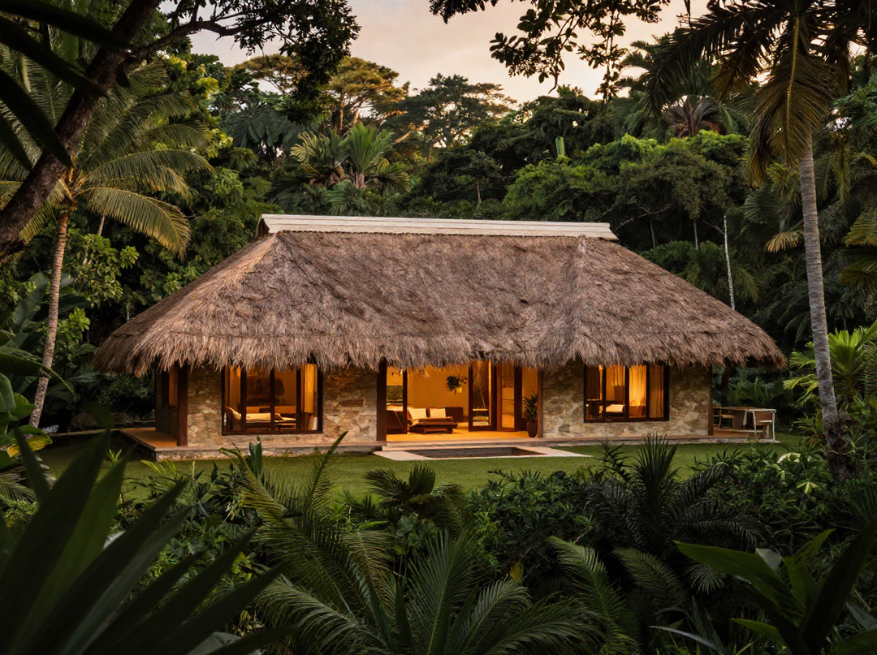
20
An expression of place that can travel home.
Building on The Alchemist Den, Love & Light Healing, and Millenheirs, the vision explores a curated relationship between botanical retail, natural lifestyle products, artisan work, and hospitality.
Future offerings could include selected teas, body care, aromatic goods, ceramics, textiles, and other thoughtfully sourced products.
The final assortment, manufacturing arrangements, and branding would be developed separately from this public overview.
Concept reference — not a launched Costa Rica collection
∀LCHƎMY | Costa Rica • Public Vision Overview • October 2026

Slide 21
21
Culture participates in the life of the place.
Art, music, storytelling, making, and gathering are envisioned as part of the landscape’s everyday life.
Local artists, producers, and knowledge holders should participate through invitation, fair compensation, and respect for their work.
The ambition is to create meaningful exchange and opportunity without reducing living cultures to decorative themes.
∀LCHƎMY | Costa Rica • Public Vision Overview • October 2026

Slide 22
22
Hospitality that makes room for people.
Belonging is central to the vision.
∀LCHƎMY is informed by an ecosystem that values Black identity, Queer belonging, gender expansiveness, spiritual inquiry, and relationships across generations.
The intention is welcoming hospitality supported by thoughtful design, respectful service, and clear practices.
∀LCHƎMY | Costa Rica • Public Vision Overview • October 2026

Slide 23
23
Space for care and shared understanding.
The broader wellness vision may include family-centered learning, body literacy, and educational opportunities informed by qualified practitioners.
Any future birth-worker or perinatal education would require a clearly defined scope and appropriate legal and professional review.
Clinical maternity care and on-site delivery services are not established components of this public vision.
∀LCHƎMY | Costa Rica • Public Vision Overview • October 2026

Slide 24
24
An approach to pursue and measure.
Regenerative ambition means examining how development decisions affect land, water, people, sourcing, and long-term operations.
Areas for evaluation include habitat-sensitive planning, responsible water use, appropriate planting, material durability, energy resilience, waste management, and maintenance.
Specific commitments and performance measures must follow site analysis, professional design, and operational planning.
∀LCHƎMY | Costa Rica • Public Vision Overview • October 2026

Slide 25
25
Consider what the development contributes.
Community development requires attention to who participates, who benefits, and how relationships endure.
The vision seeks to evaluate opportunities for local sourcing, compensated collaboration, appropriate employment, learning pathways, and shared cultural life.
These opportunities must be shaped with community input and supported by practical agreements.
∀LCHƎMY | Costa Rica • Public Vision Overview • October 2026

Slide 26
26
Mission alignment with clear boundaries.
Fertile Ground Incorporated and True Alchemy Gardens carry their own nonprofit missions.
Their work informs the ecosystem’s understanding of housing stability, community development, food access, and environmental stewardship.
Any future connection to Costa Rica programming would require separate evaluation, governance, agreements, and appropriate legal review.
Nonprofit contributions and commercial investment must remain clearly distinguished.
∀LCHƎMY | Costa Rica • Public Vision Overview • October 2026

Slide 27
27
Different relationships with one evolving vision.
The presentation welcomes:
Customers who want to understand the next chapter.
Practitioners, artists, growers, and makers exploring alignment.
Landowners and development professionals interested in appropriate conversations.
Potential investors who want to understand the founding vision and development leadership.
Community organizations interested in mission-specific dialogue.
∀LCHƎMY | Costa Rica • Public Vision Overview • October 2026

Slide 28
28
Connected experiences, disciplined development.
The concept explores complementary commercial activities rather than relying on a single experience.
Potential areas include hospitality, wellness programming, food and beverage, curated retail, and appropriately structured gatherings or educational experiences.
The final business model must be tested against market demand, site conditions, operating costs, capital requirements, and regulatory obligations.
∀LCHƎMY | Costa Rica • Public Vision Overview • October 2026

Slide 29
29
A process that turns vision into informed decisions.
1 Concept definition and alignment.
2 Legal structure and rights.
3 Site suitability and feasibility.
4 Capitalization and agreements.
5 Design and approvals.
6 Delivery and operational readiness.
The sequence is illustrative. Stages may overlap or change as diligence informs the project.
∀LCHƎMY | Costa Rica • Public Vision Overview • October 2026

Slide 30
30
What must be established before delivery.
Advancement requires evidence and coordinated professional work.
Key areas include land rights, permitted uses, environmental conditions, access and infrastructure, design suitability, operating requirements, commercial feasibility, and governance.
TARAD’s role is to coordinate the development direction and the relationships required to address these questions.
∀LCHƎMY | Costa Rica • Public Vision Overview • October 2026

Slide 31
31
Stay connected through the ecosystem you already know.
Visit and shop The Alchemist Den.
Explore its currently available offerings and events.
Subscribe for future vision updates.
Share thoughtful introductions and relevant expertise.
Supporting an existing business or attending an existing program does not create an investment interest in ∀LCHƎMY.
https://www.alchemistden.com
https://www.alchemistden.com/contact
∀LCHƎMY | Costa Rica • Public Vision Overview • October 2026

Slide 32



√LCH3MY | Costa Rica
Vision & Collaboration Overview
Begin with a conversation about alignment.
We welcome introductory conversations with practitioners, artists, growers, makers, educators, and experience providers whose work aligns with
the vision.
An introduction should describe your practice, location, relevant experience, and the contribution you would like to explore. Participation would depend on mutual fit, project needs, professional requirements, and appropriate agreements.
YLCH3MY | Costa Rica • Public Vision Overview • October 2026

Slide 33


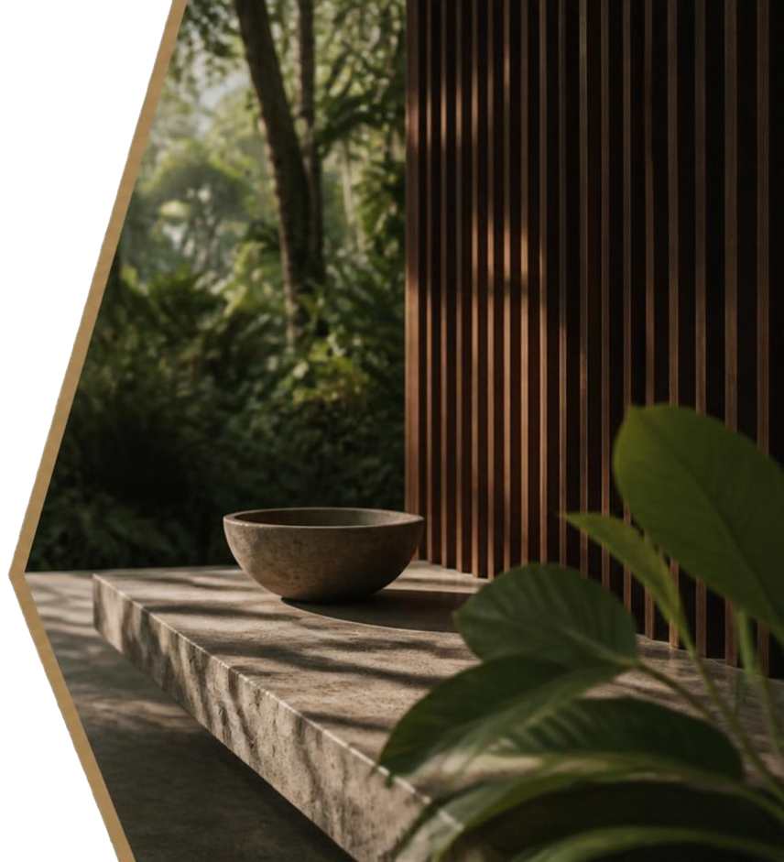

LCHEMY | Costa Rica
Bring relevant opportunities and expertise.
Landowners and professionals may begin a conversation with TARAD about opportunities, technical capabilities, or development collaboration.
Useful introductions explain the opportunity or expertise, relevant experience, and how it may support responsible project evaluation.
Property-specific and commercially sensitive discussion should proceed through an
appropriate private process.
YLCH3MY | Costa Rica • Public Vision Overview • October 2026

Slide 34


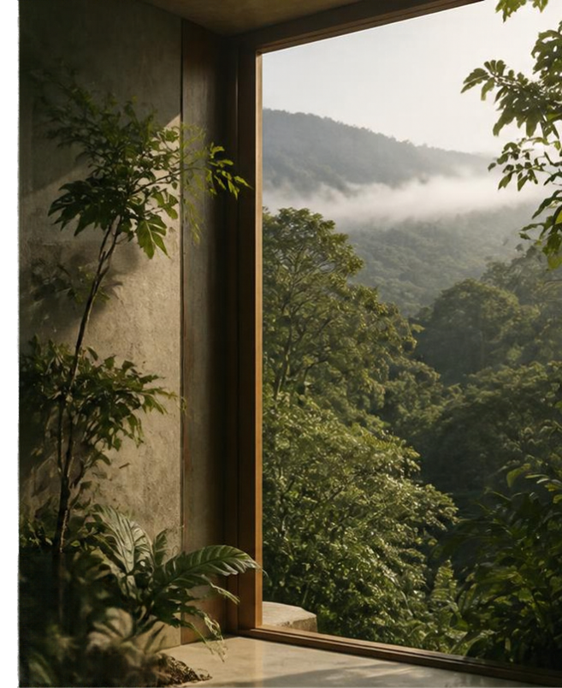

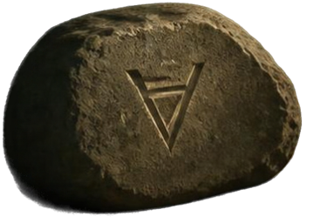
LCHEMY | Costa Rica
Start with the vision and
the development leadership.
Potential investors are invited to request an introductory discussion with TARAD. The initial conversation can explore alignment, relevant experience, development objectives, and whether further discussion is appropriate.
Project-specific information, financial analysis, and any proposed participation would be addressed separately through a structured private process and appropriate
legal documentation.
This public overview does not contain
investment terms or an offer to invest.
√LCHEMY | Costa Rica • Public Vision Overview • October 2026

Slide 35

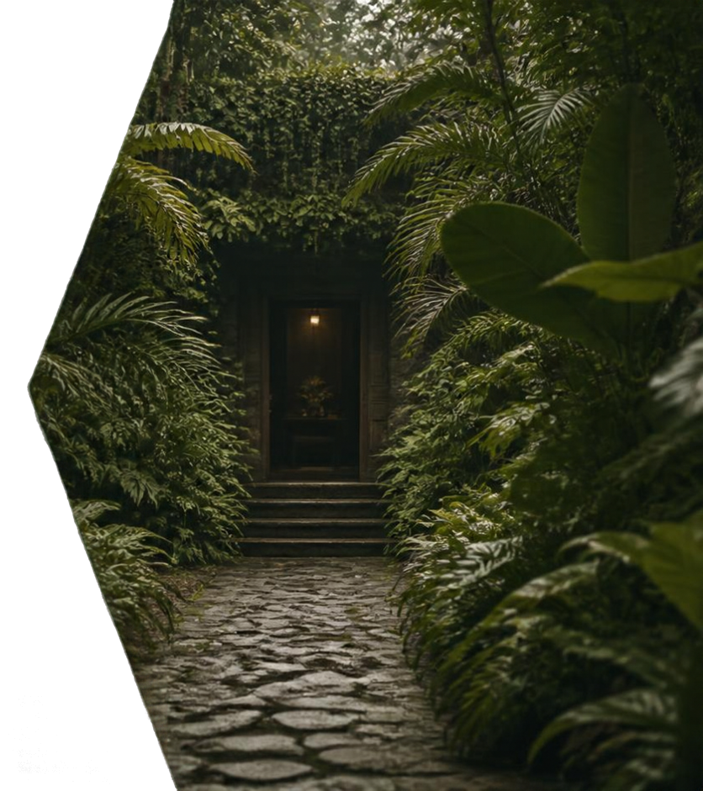







LCH3MY | Costa Rica
Vision & Collaboration Overview
Connect through the appropriate organization.
Community and nonprofit collaboration should begin with the organization whose mission fits the proposed work.
Housing stability and community-development
conversations may relate to Fertile Ground Incorporated.
Food-access, garden, and environmental-stewardship
conversations may relate to True Alchemy Gardens.
Commercial development and investment
conversations should be directed to TARAD.
YLCH3MY | Costa Rica • Public Vision Overview • October 2026

Slide 36


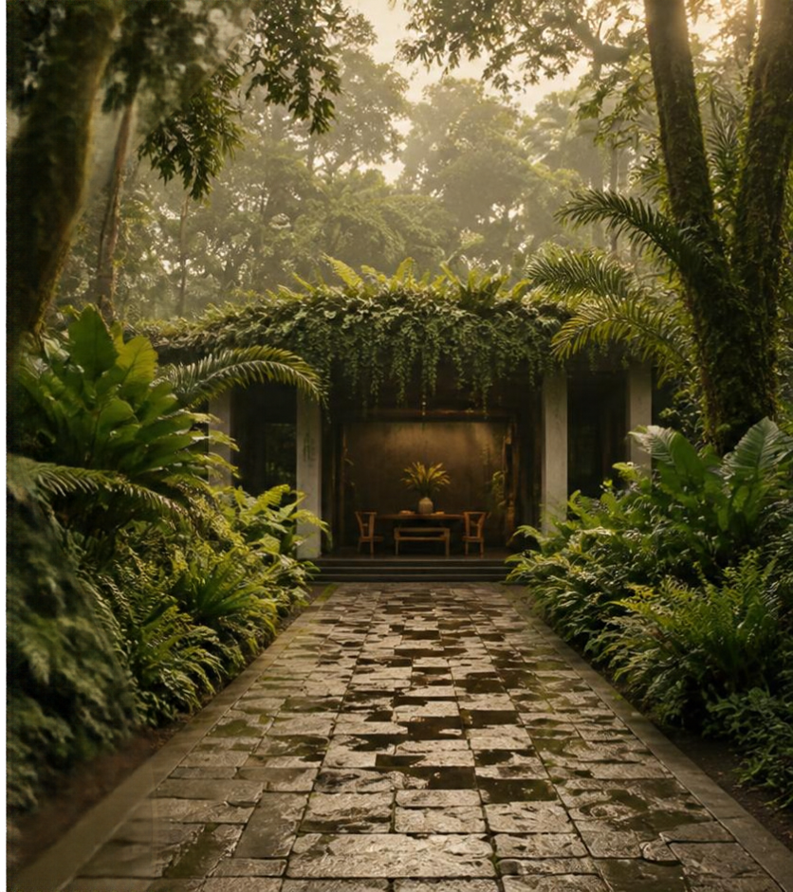

Tell us how you
would like to connect.
In your introduction, please include:
  Your name and organization.
  Your location.
  Your area of interest.
  Relevant experience or capabilities.
  The relationship or contribution you would like to explore.
  Your preferred contact information.
For development or potential investment inquiries, identify your message for Tă Millen / TARAD.
https://www.alchemistden.com/contact
Y/Y LCH3MY | Costa Rica • Public Vision Overview • October 2026

Slide 37


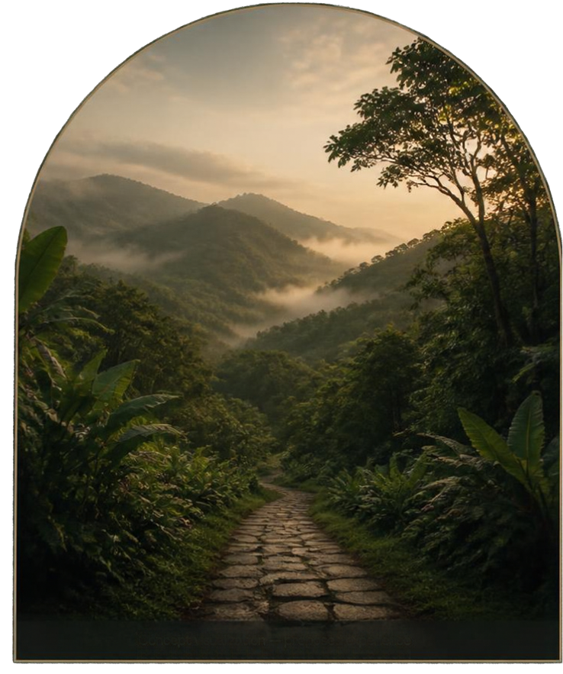
A place with purpose, developed with intention.
The ambition is to create a place whose hospitality, landscape, culture, and commercial life strengthen one another.
For Tä, VˈLCH3MY connects the work of becoming with the responsibility of developing: shaping a vision, building relationships, testing assumptions, and creating the conditions for something meaningful to endure.
YˈLCH3MY | Costa Rica • Public Vision Overview • October 2026
Concept visualization — proposed experience

Slide 38


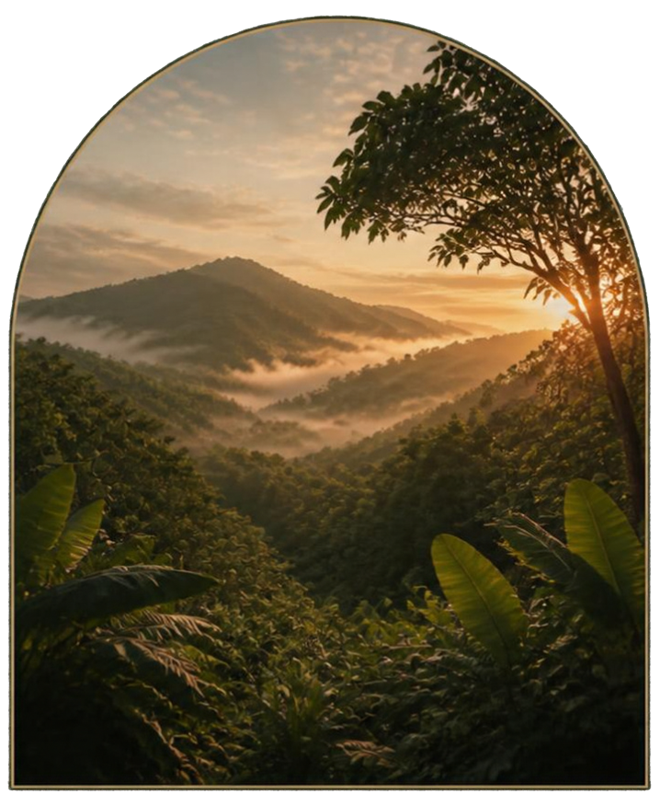


VLCH3MY | Costa Rica
A vision taking shape.
A journey grounded in intention.
An invitation to begin a conversation.
Originated and led by Tä Millen
The Alchemist's Realty & Design, LLC
https://www.alchemistiden.com
https://www.alchemistiden.com/contact
YLCH3MY | Costa Rica • Public Vision Overview | October 2026

Slide 39


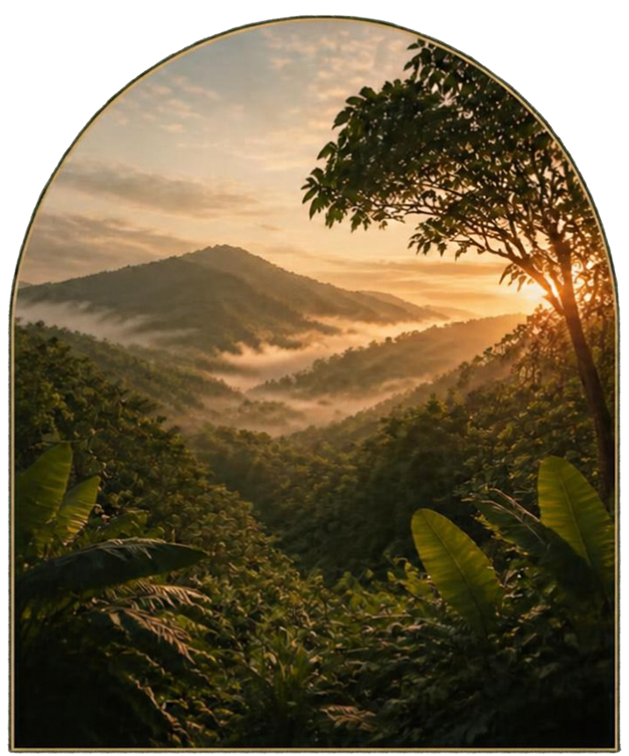
About this overview.
This presentation describes an evolving development vision. Illustrations and concept visualizations do not depict a completed or approved project.
Facilities, programming, commercial activities, and organizational relationships remain subject to feasibility, legal structuring, agreements, funding, design, and approvals.
No site ownership, committed financing, regulatory approval, opening date, or availability for booking is represented.
This overview is informational and is not an offer to sell securities, an invitation to purchase investment interests, or a commitment to provide accommodation or services.
Please contact the originating development team for permissions relating to original presentation materials.
YLCH3MY | Costa Rica + Public Vision Overview | October 2026

